Slide 1
State of Obesity and Selected Social Determinants of Health in the United States
The Sassy Stingrays
Daniel Byrne
Erin Cullen
Steven Orn
Greg Rosen
Vilma Santos

Slide 2
Project Goal
Allow users to explore how various social determinants
– such as economic status and availability of restaurants –
might affect the incidence of obesity in the United States

Slide 3
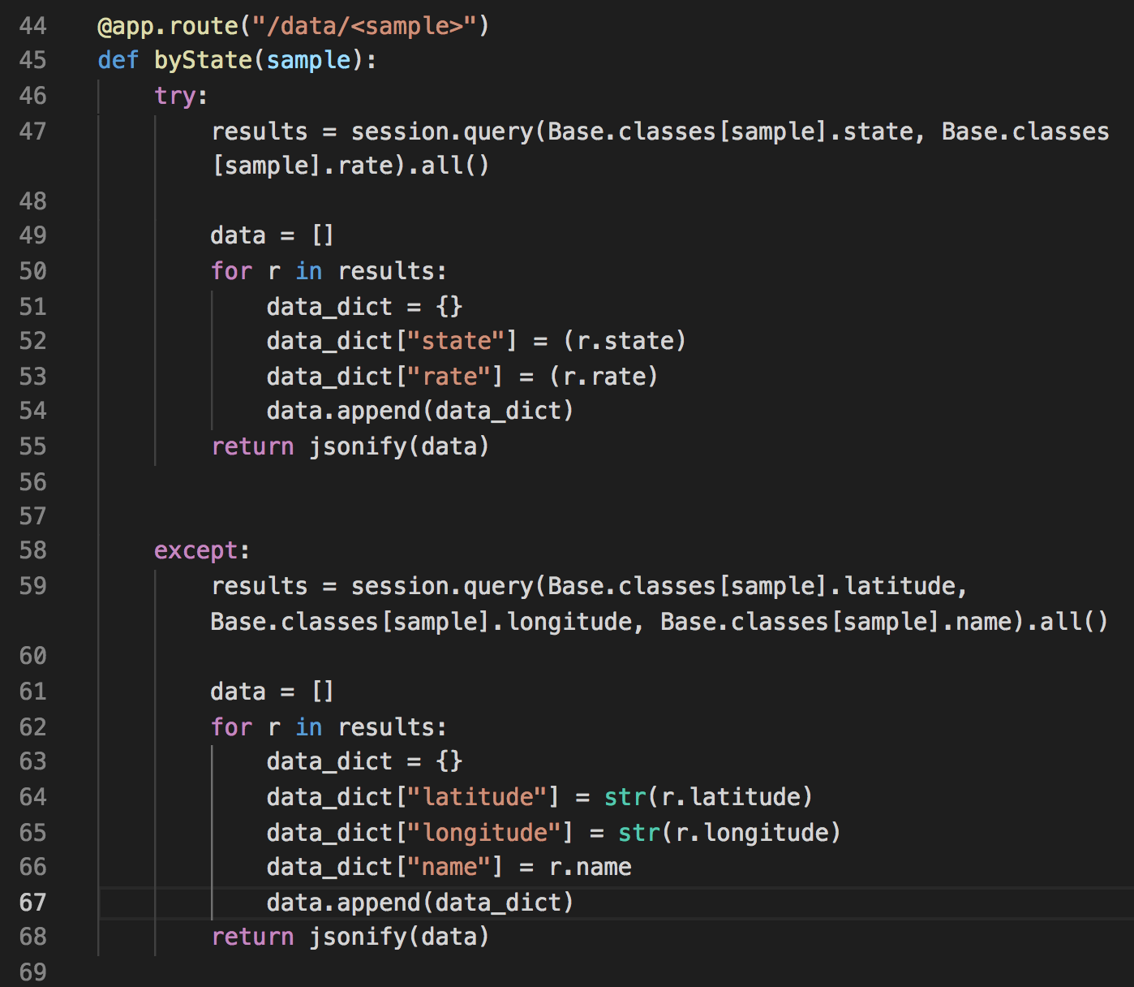
Used Python’s Flash Framework to build various routes on the site.
Data was returned from the sqlite database with either a latitude and longitude or a state name and a rate.

Slide 4
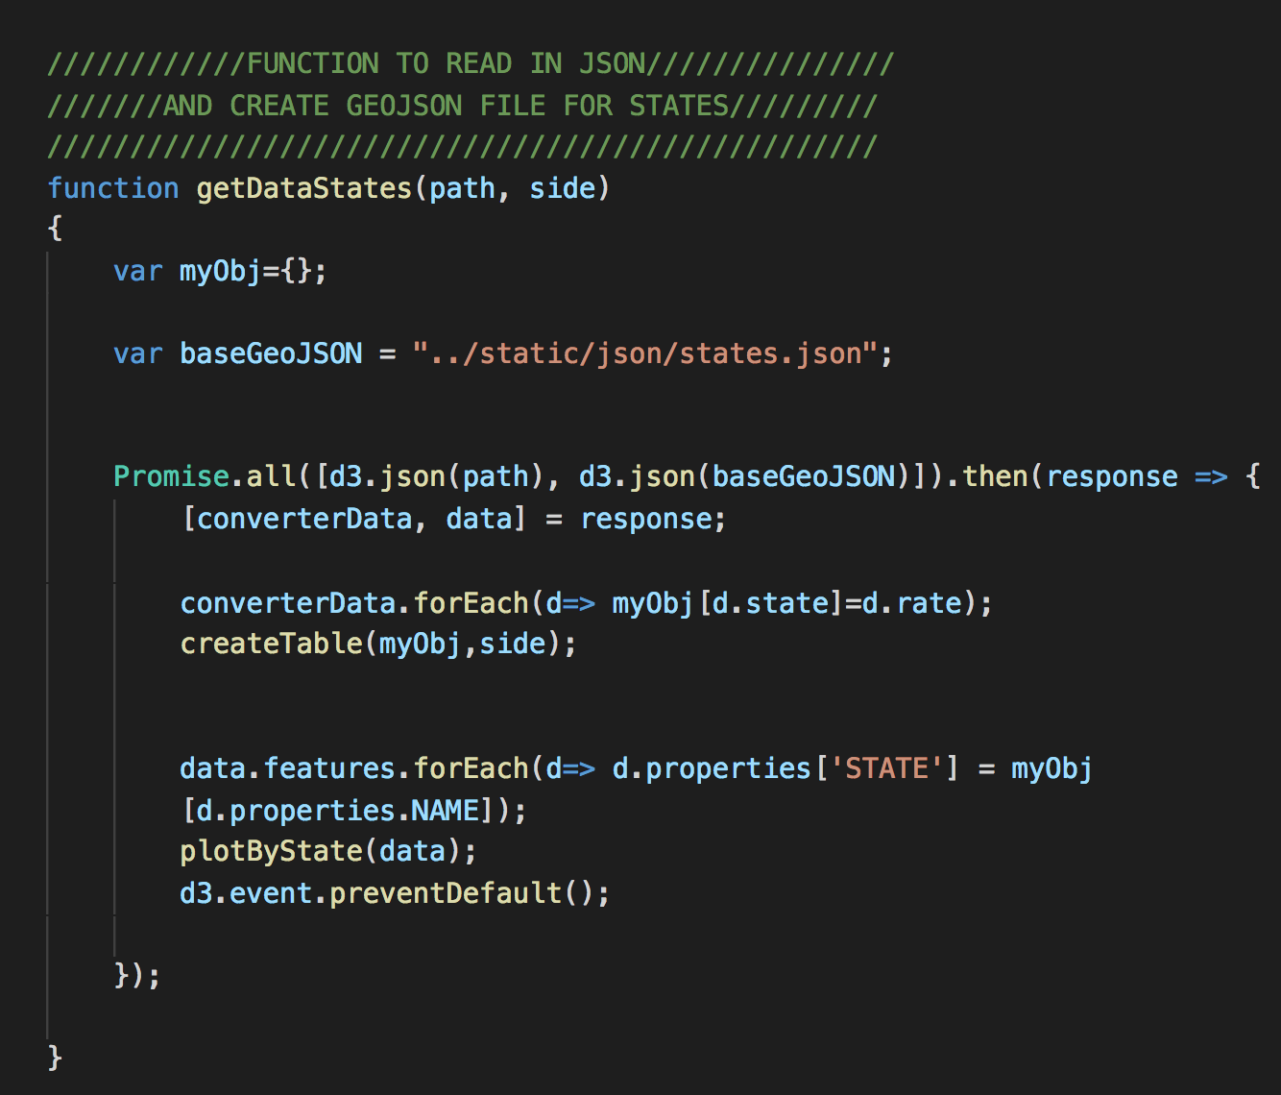
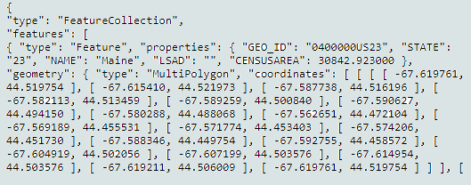
Used JavaScript’s leaflet library to graph the data on a map of the US.
We used a GEO JSON file to get the outlines of each state.

Slide 5

SCROLLAMA
We used Scrollama as our additional JS library
Scrollama is a modern & lightweight JavaScript library for scrollytelling using IntersectionObserver in favor of scroll events.

Slide 6
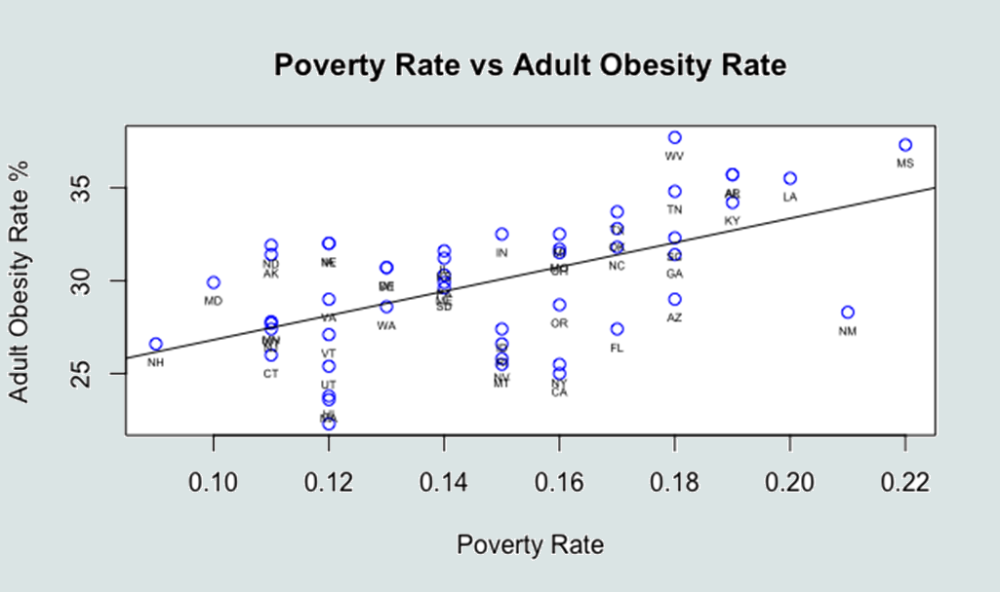

Slide 7
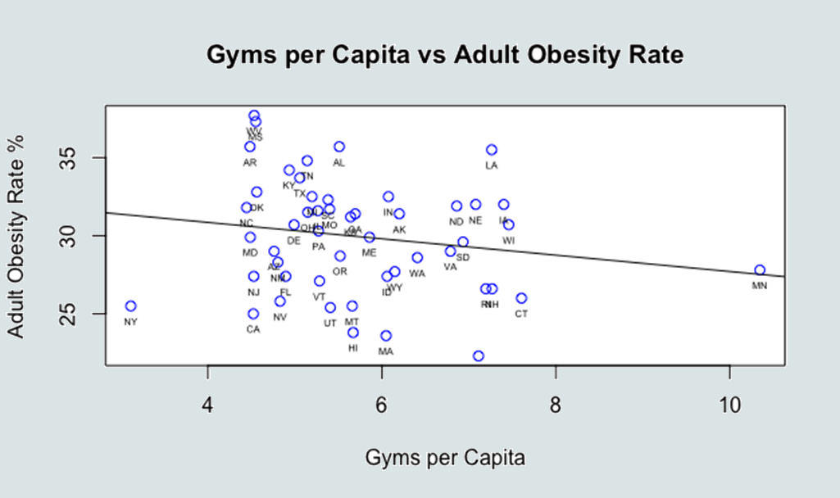

Slide 8
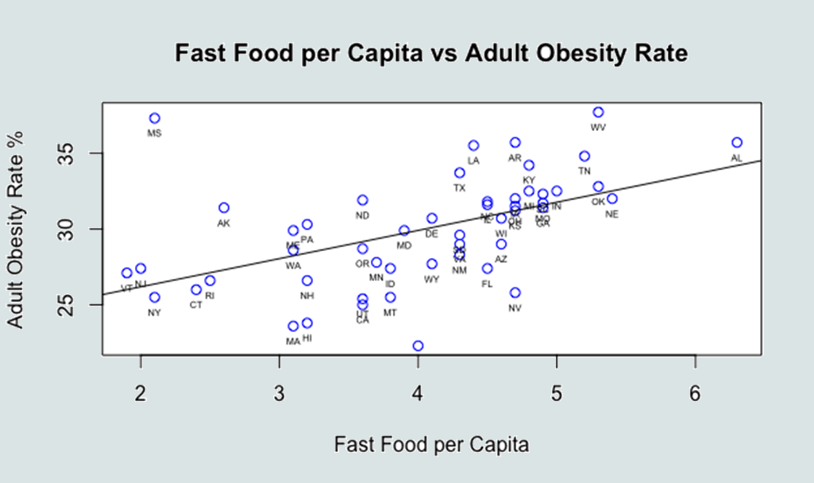

Slide 9
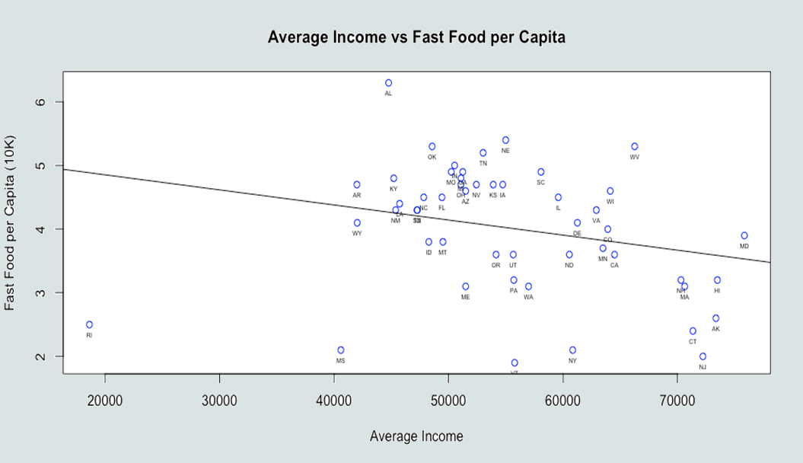

Slide 10
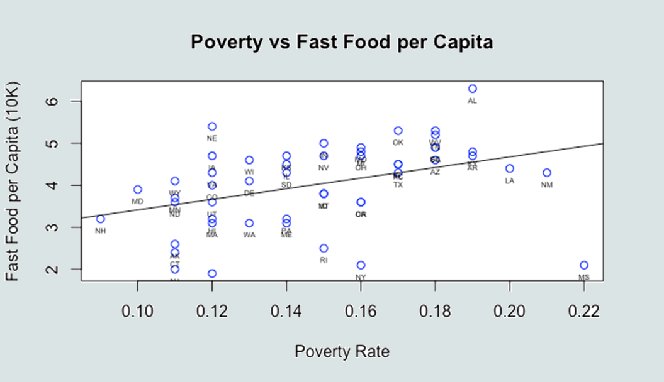

Slide 11
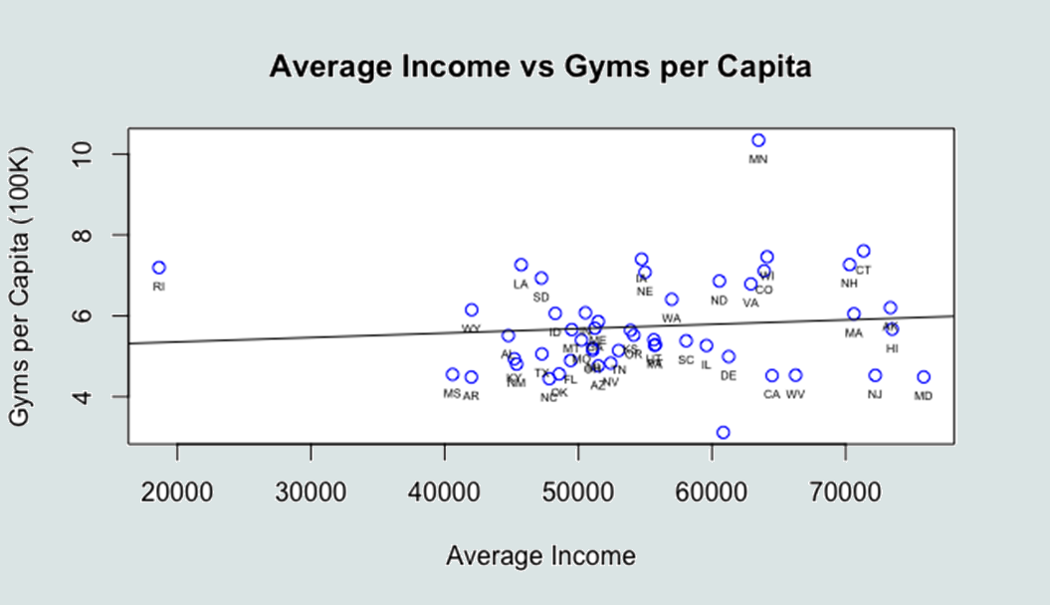

Slide 12
Continued Research
Is our fast food data a representative sample?
Is the methodology of the Behavioral Risk Factor Surveillance System (BRFSS) sound?
The eternal struggle between correlation and causation
Dozens of other factors could provide useful information

